Slide 1
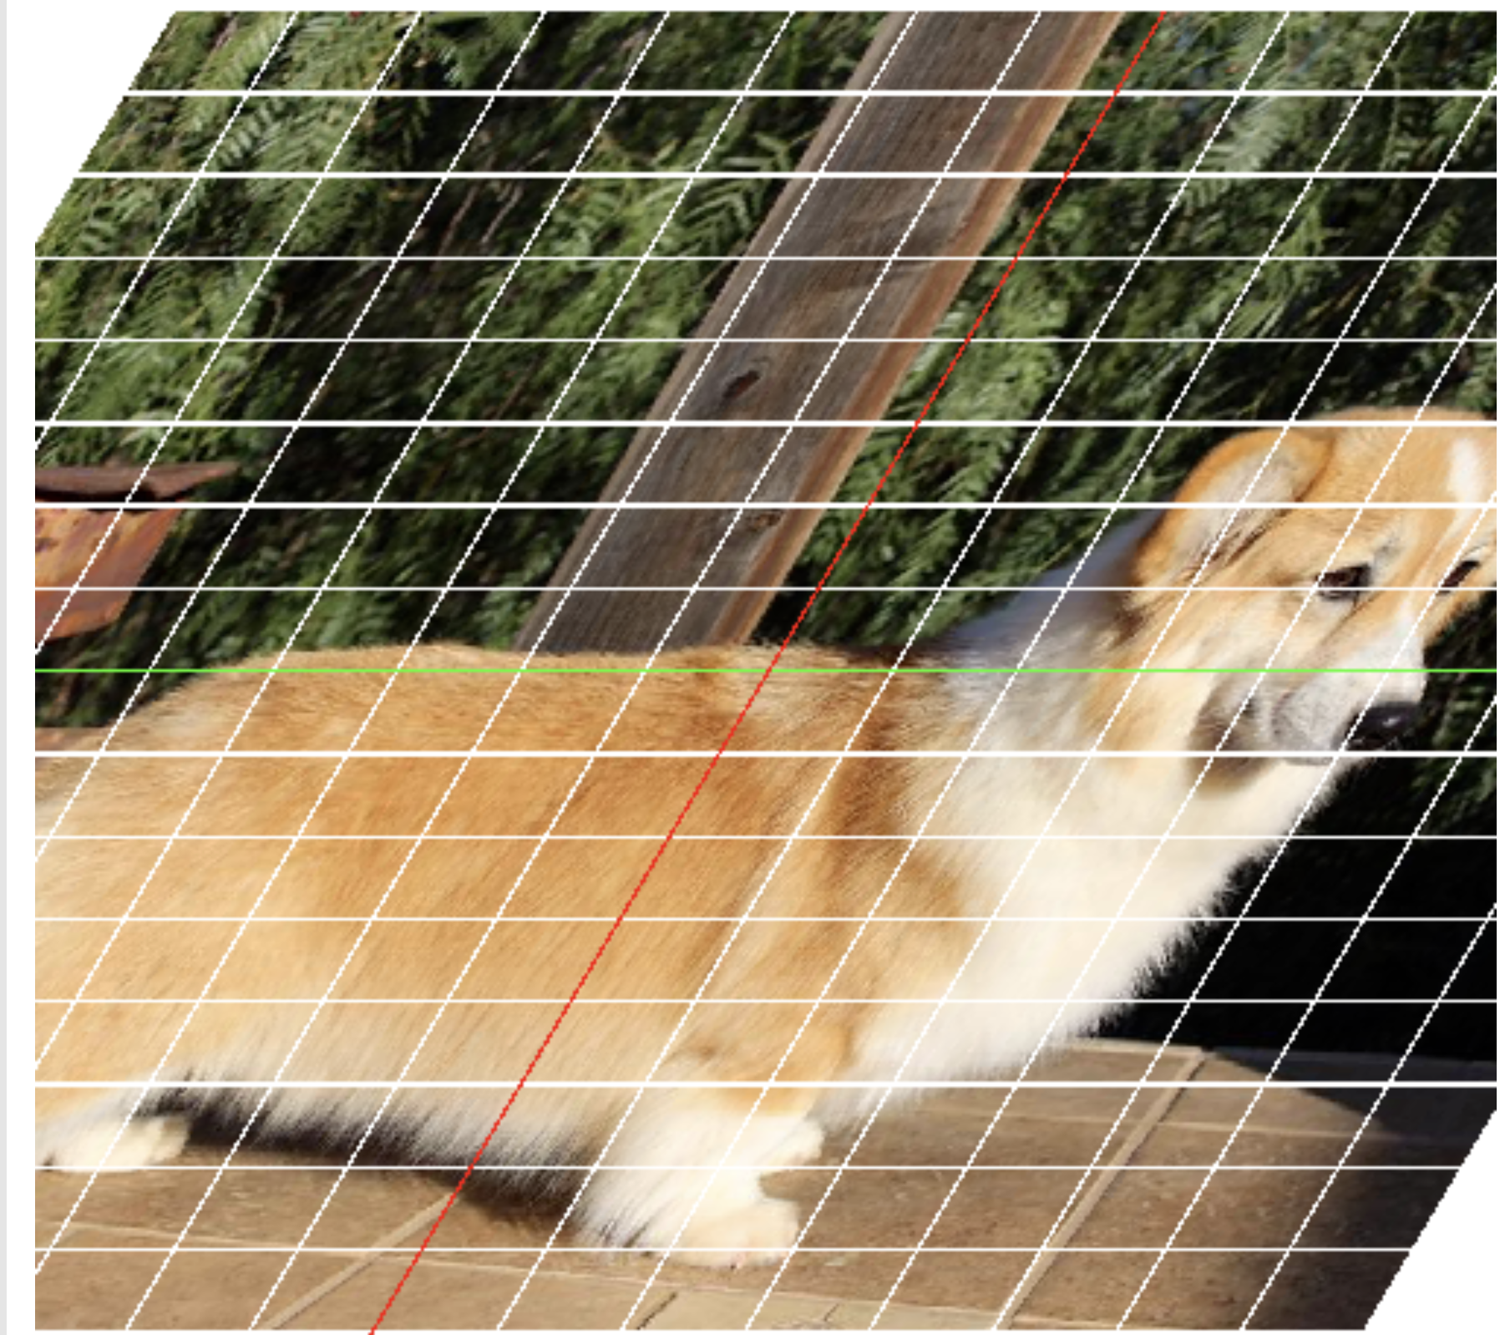
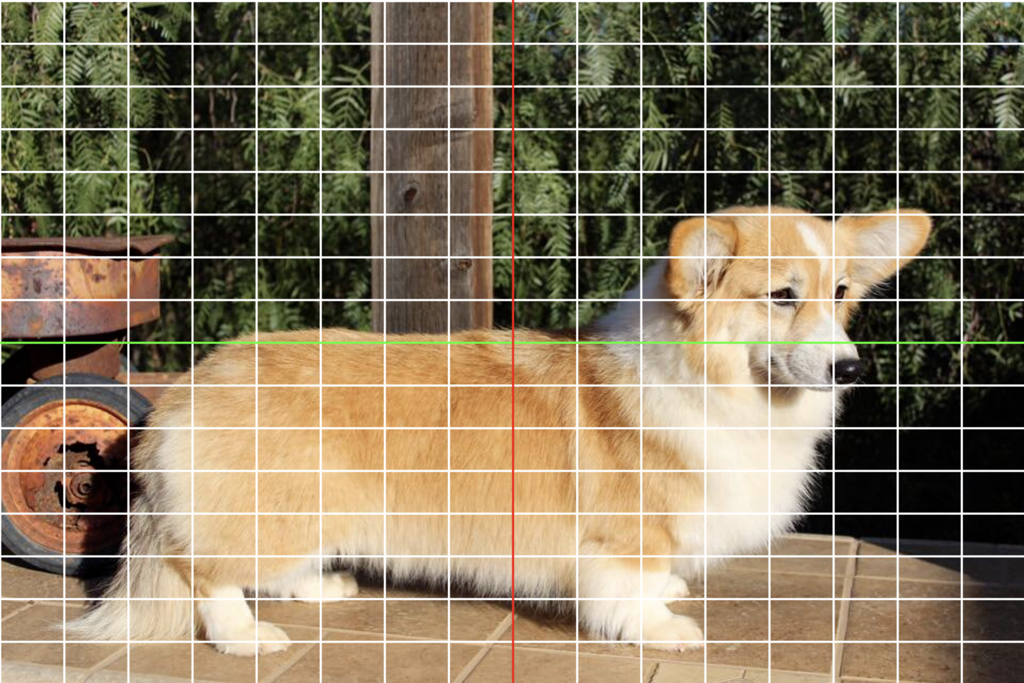






(1,1)
(500,1)
(1,1)
(1,cols)
(i,j)
(rows/2, cols/2)
(500,1)
(500,500)
size = 500 x 500
(rows,1)
(cols,1)
T(1,1)
(cols x cols)
(-1,1)
(0, 1)
(1,1)
scale factor =
cols/2
translate 0,0 to rows/2,cols/2
and interchange the coords and flip y
T(-1,1)
trygetpixel
T
(-1,1)
(1,1)
T⁻¹
T(-1,-1)
(x,y)
(0,0)
T(1,-1)
(-1,-1)
(0,-1)
(1,-1)
(-1,-1)
(1,-1)
(out_x, out_y)
(2 x 2)

Slide 2
Transformations and their inverses
Coordinate Transformations
We’ve chosen to backwards to grab the pixel because we want to know where it comes from
split output into pixels
Commutative Diagrams
Inverse of a Transformation
Breakdown (as in failure) of an inverse
collapsing shear
singular matrices
Solving systems
Linear equations
Solving Systems f(x) = y for nonlinear
The Jacobian matrix = the local linear thing (as clear as possible)
failure/breakdown = singular jacobian by the way

